Slide 1
Investment

Slide 2
Categorize the Risk-Factor:
Categorizing the companies in terms of different risk factors
High –Risk taking:
For this we need to satisfy the conditions market cap(cr) less than 5000 and 10-year return(%)less than 8.
Low –Risk taking:
For this we need to satisfy the conditions market cap(cr) in between 5000 and 8000 and 10-year return(%) between 8 and 15.
Moderate –Risk taking:
For this we need to satisfy the conditions market cap(cr) in between 8000 and 18000 and 10-year return(%) between 15 and 20.
Risk taking:
For this we need to satisfy the conditions market cap(cr) more than 18000 and 10-year return(%) more than 20.

Slide 3
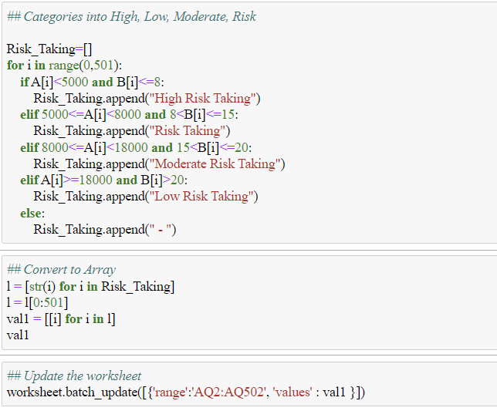
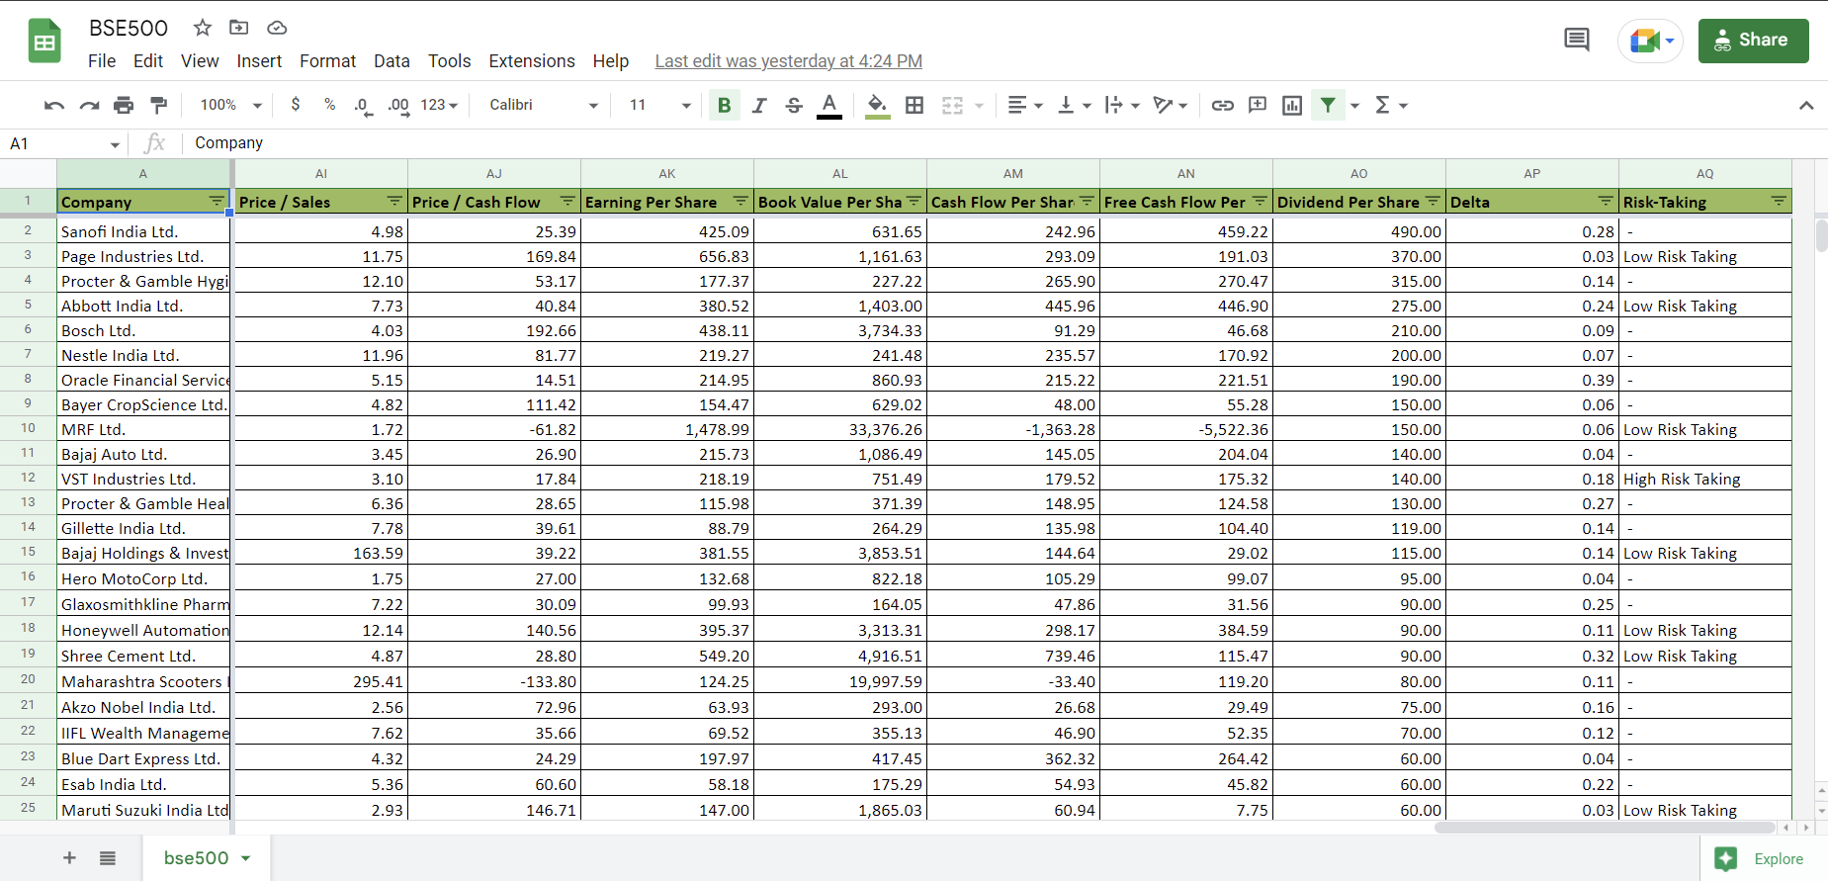
Code for Categorizing Risk-Factors:

Slide 4
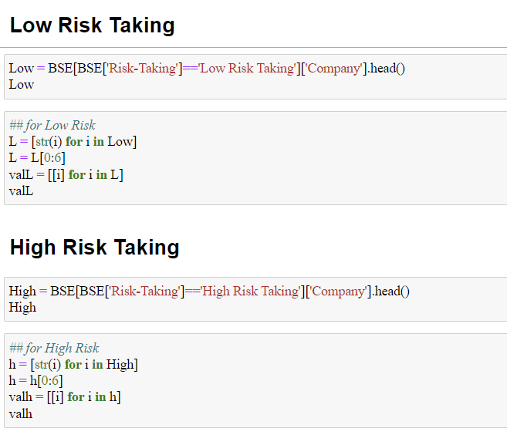
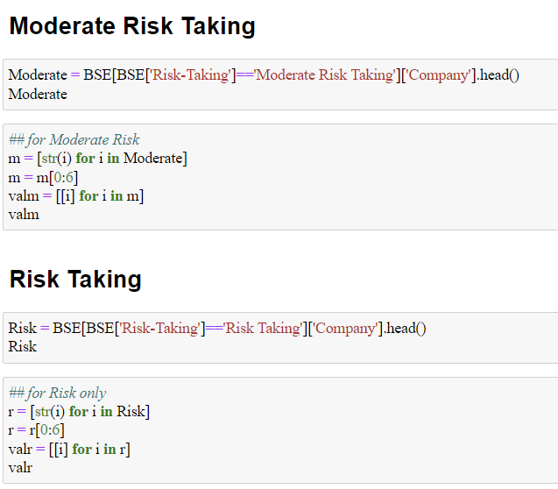
Categorize Top 5 companies for different Risk-factors:

Slide 5
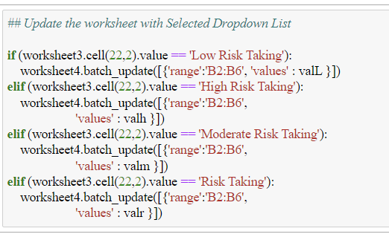
Calling the companies which need to be invested according to Risk-Factors:
By using this code, we found the top 5 companies where the money need to be invested.
By selecting type of investment profile wants to find the companies where amount to be invested will also change.

Slide 6
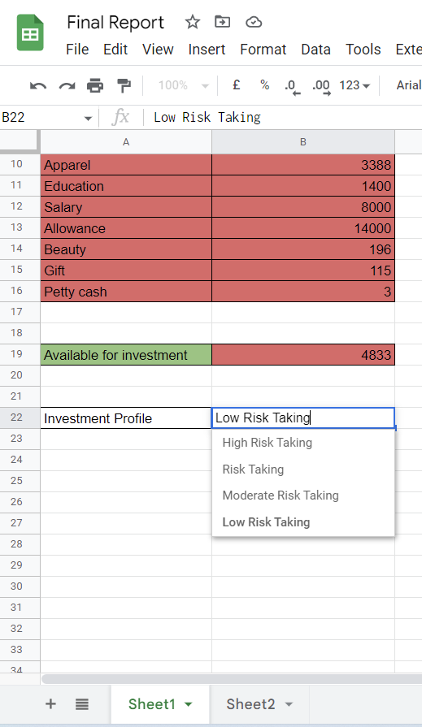
Amount to be invested in top 5 companies for different Risk-Takings:
Depending upon our analysis we found out 4 ways of investing i.e.
Low-Risk Taking
High Risk-Taking
Moderate Risk-Taking
Risk-Taking

Slide 7
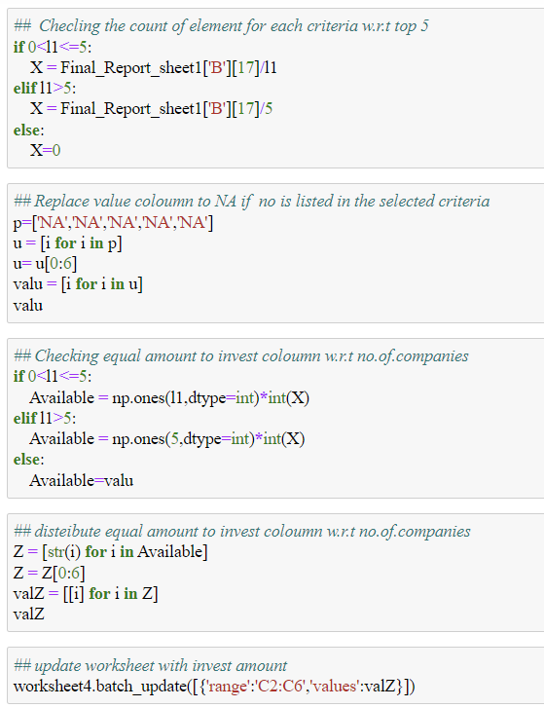
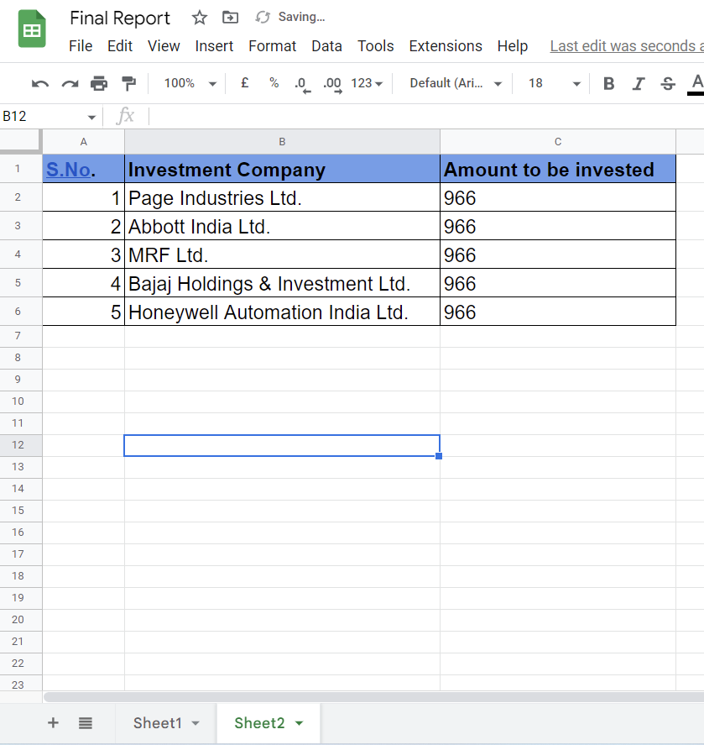
Code for Calculating amount invested:

